Slide 1
Chongqing University of Technology
ATAI
Advanced Technique of Artificial Intelligence
Chongqing University of Technology
Graph Auto-encoder
Made by JiaWei Cheng

Slide 2
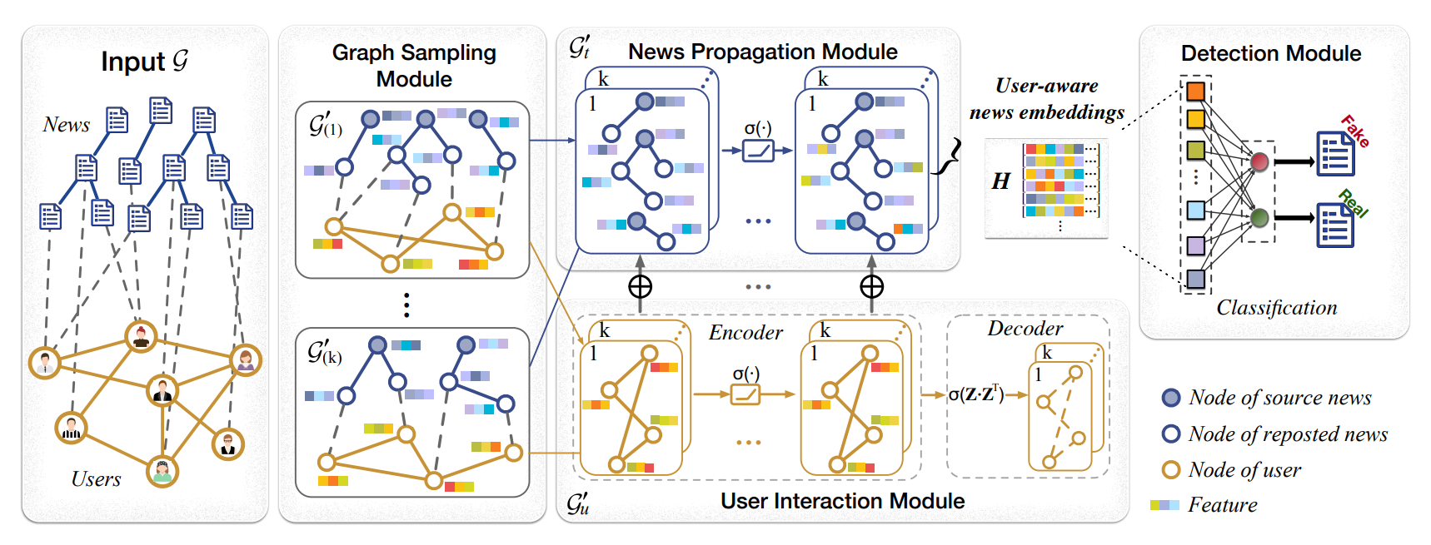
Mining User-aware Multi-relations for Fake News Detection in
Large Scale Online Social Networks

Slide 3
图自编码器的重构损失

Slide 4
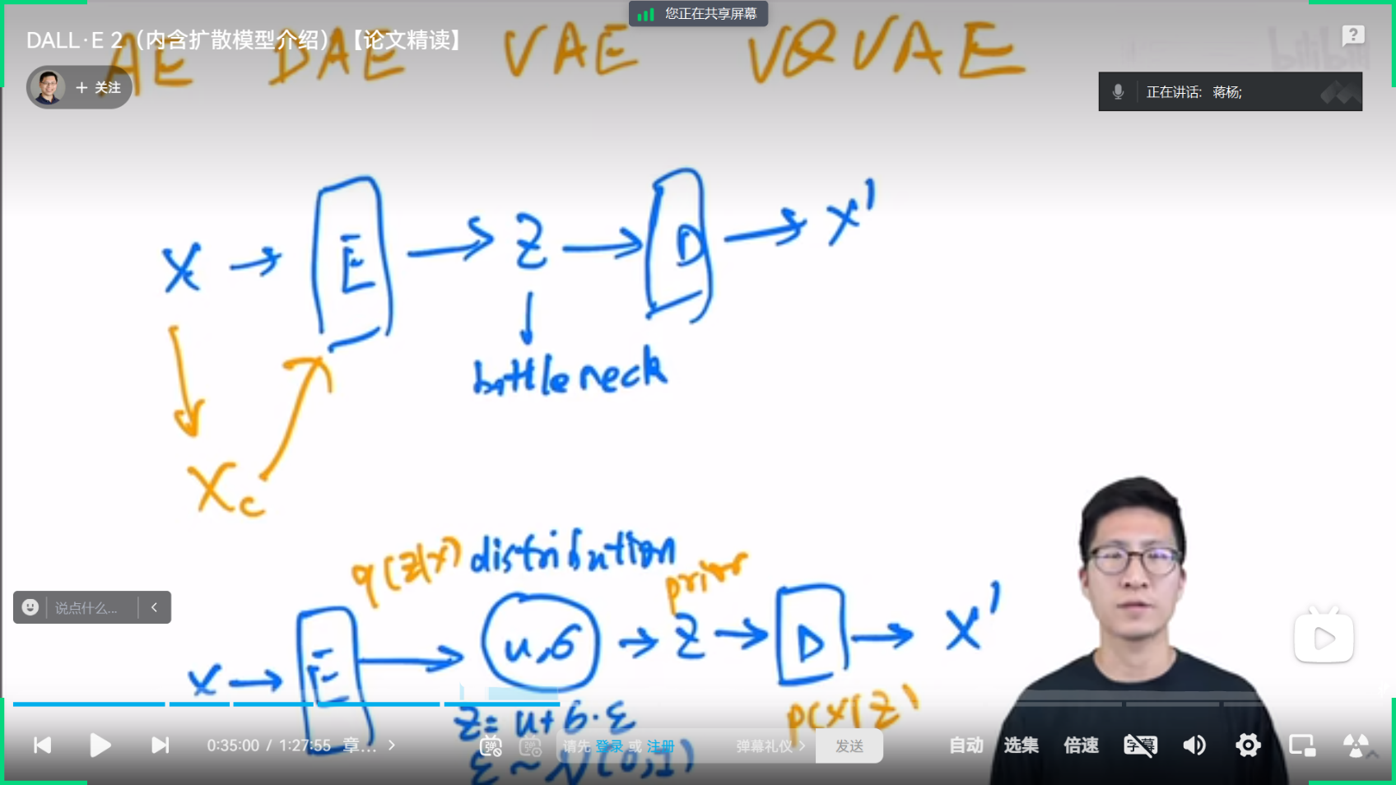
VAE
https://www.bilibili.com/video/BV17r4y1u77B/?vd_source=e87a1ead2be88d1ae28f623b30aa201f

Slide 5
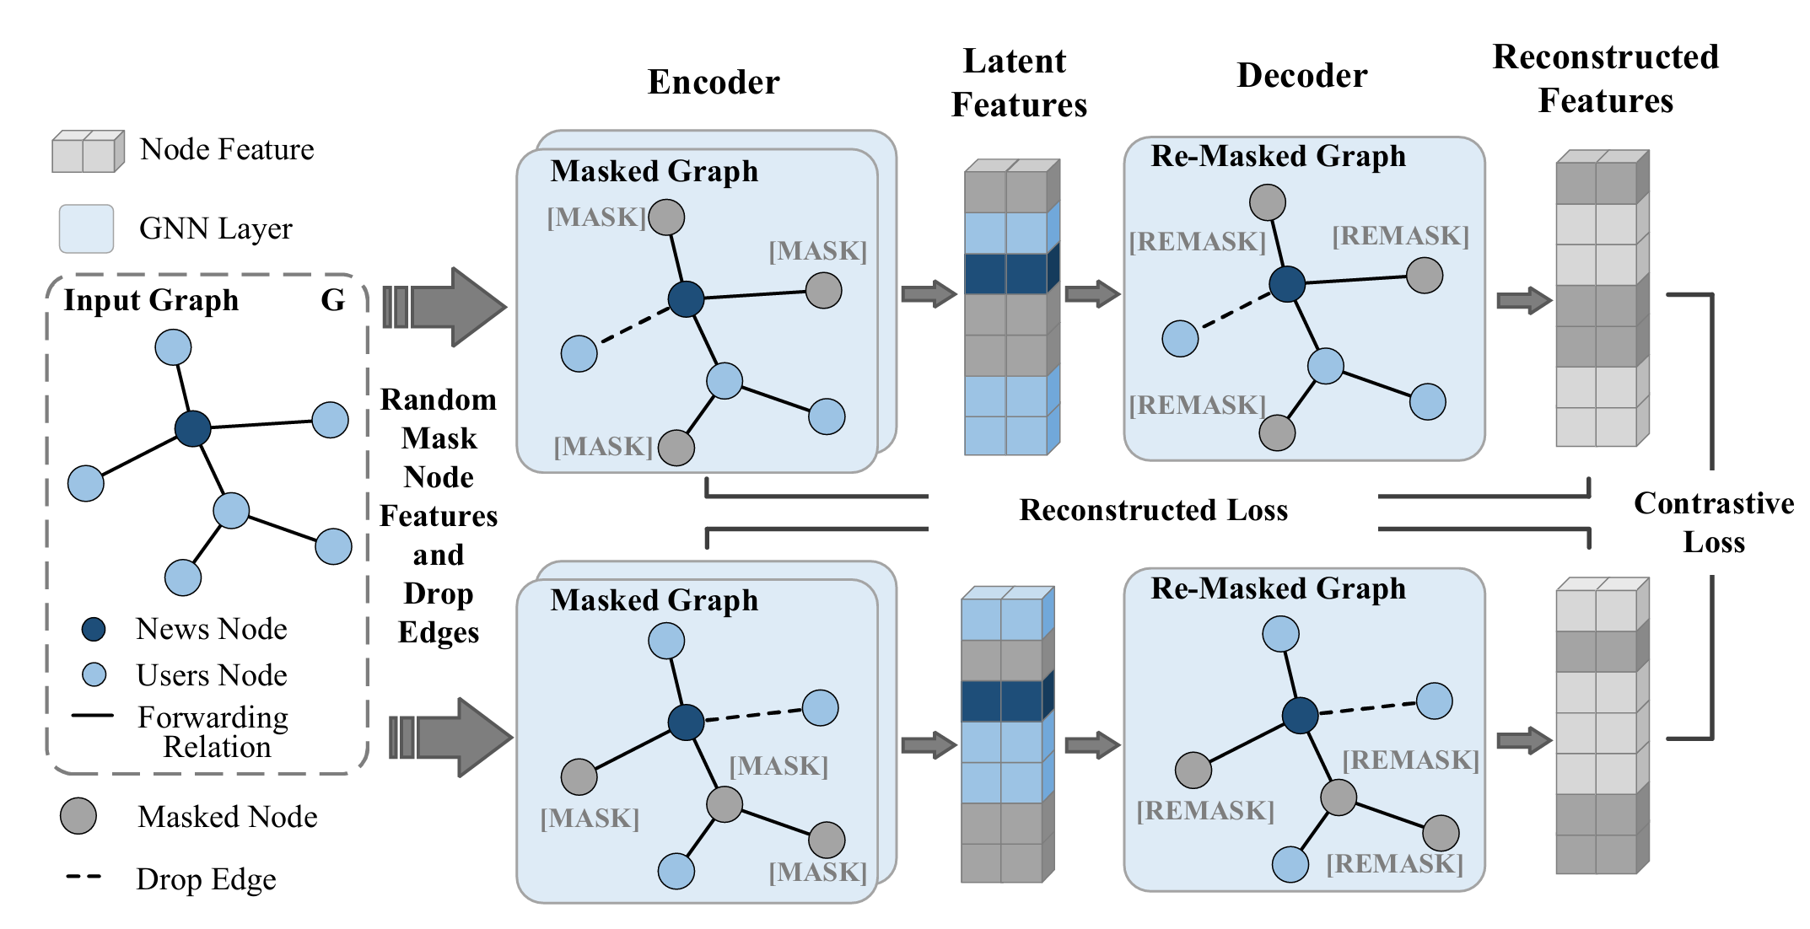
AAAI_2024_An Unsupervised Method for Fake News Detection using Graph Autoencoder with Masking

Slide 6
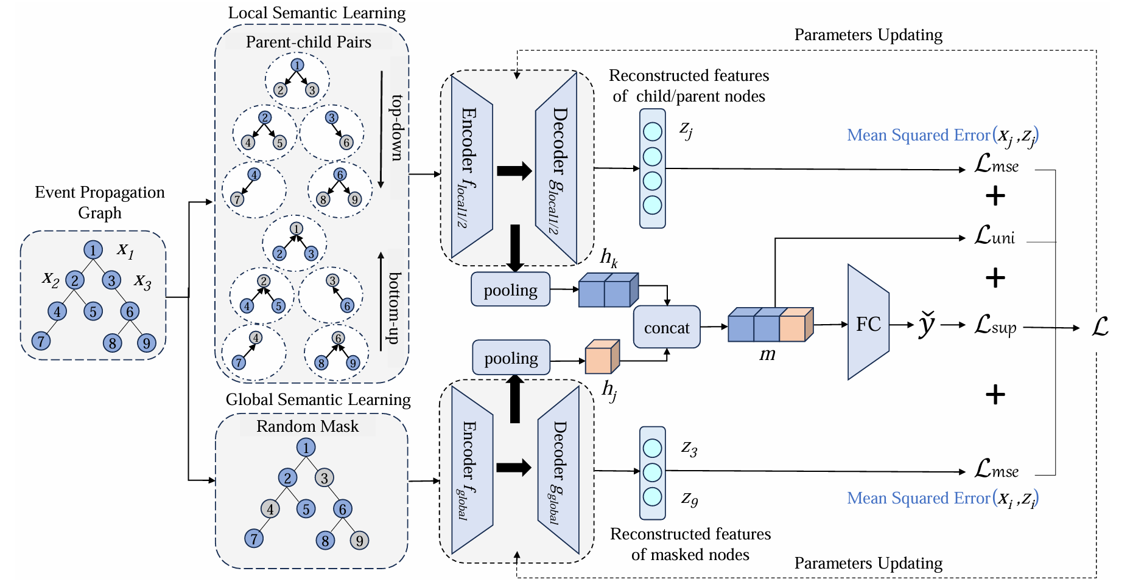
WWW_2024_Semantic Evolvement Enhanced Graph Autoencoder

